Slide 1

Semantic Web Services and Cloud Platforms
Notes:
1

Slide 2
Web Services
Discovery Services
Service Description
Find
(discovery)
Publish
(registration)
Service Requester
(Client)
Interact
(delivery)
Service Provider
Service Description
Notes:
2

Slide 3
RESTful services
Representational State Transfer (REST) is an architectural style that makes information available as resources identified by URIs: applications communicate by exchanging representations of these resources using a transfer protocol such as HTTP.
Resources are key to Web architecture: server-controlled abstractions an application process makes available, identified via URIs.
Clients access these server controlled resources in a synchronous request–response fashion using methods such as GET, PUT, POST and DELETE.
Bormann, C.; Castellani, A.P.; Shelby, Z., "CoAP: An Application Protocol for Billions of Tiny Internet Nodes," Internet Computing, IEEE , vol.16, no.2, pp.62,67, March-April 2012.

Slide 4
Services for mobile world
In mobile environments the devices can take two key roles:
Service Provider
Service Consumer
To run and/or consume a service in mobile environments you need to consider:
Mobility and ubiquity issues
Energy-consumption and power efficacy
Bandwidth and delay and in general QoS
Reliability and Quality of Information

Slide 5
Services for Tiny Devices
The Constrained Application Protocol (CoAP)
CoAP is a transfer protocol for constrained nodes and networks, such as those that will form the Internet of Things.
CoAP uses the REST architectural style.
It is based on UDP.
CoAP’s aim is to achieve its modest goals with considerably less complexity.
Bormann, C.; Castellani, A.P.; Shelby, Z., "CoAP: An Application Protocol for Billions of Tiny Internet Nodes," Internet Computing, IEEE , vol.16, no.2, pp.62,67, March-April 2012.

Slide 6
IPV6 on constrained devices- 6LoWPAN
The IETF has already undertaken much standardization work to make the packets flow. The IPv6 over Low-Power Wireless Area Networks
(6LoWPAN) standards (RFCs 4944 and 6282) now enable IPv6 even on very constrained networks — including the popular IEEE 802.15.4 wireless standard, ISM (industrial, scientific, medical) band telemetry radios, and low-rate power-line communications (PLC), all while using very simple embedded microcontrollers.
Bormann, C.; Castellani, A.P.; Shelby, Z., "CoAP: An Application Protocol for Billions of Tiny Internet Nodes," Internet Computing, IEEE , vol.16, no.2, pp.62,67, March-April 2012.

Slide 7
CoAP
A central element of CoAP’s reduced complexity is that, instead of TCP, it uses UDP and defines a very simple “message layer” for retransmitting lost packets.
It is based on XML and its compact binary representation, EXI.
Bormann, C.; Castellani, A.P.; Shelby, Z., "CoAP: An Application Protocol for Billions of Tiny Internet Nodes," Internet Computing, IEEE , vol.16, no.2, pp.62,67, March-April 2012.

Slide 8
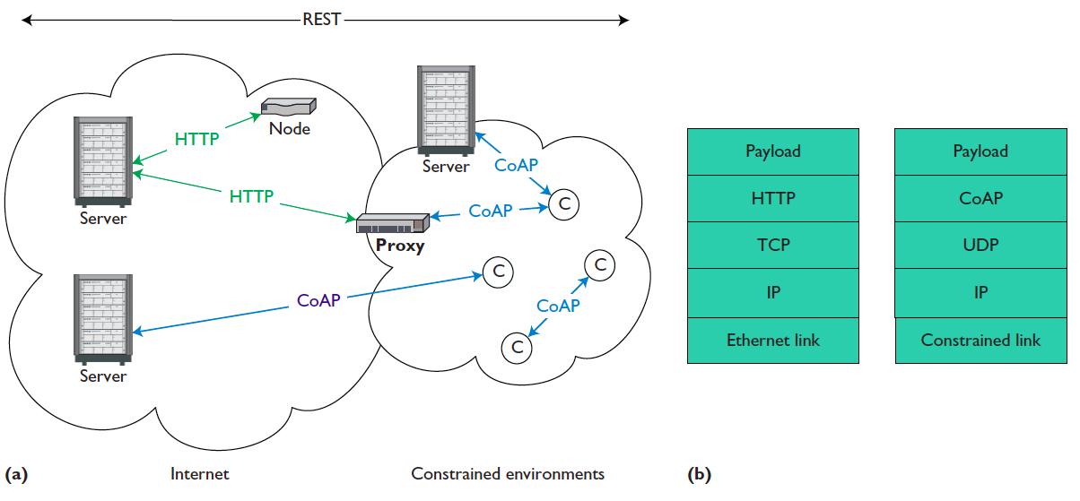
HTTP and the Constrained Application Protocol (CoAP)
Bormann, C.; Castellani, A.P.; Shelby, Z., "CoAP: An Application Protocol for Billions of Tiny Internet Nodes," Internet Computing, IEEE , vol.16, no.2, pp.62,67, March-April 2012.

Slide 9
Web Services and Semantics
Semantic Web focuses on interoperable data and knowledge representation.
Services focus on interoperable software design.
A match made in heaven!
Semantic Web Service
(Semantics + Web Service)

Slide 10
Why we need “Semantic” descriptions for the Services
To have more flexibility, adaptability, automation
Ability of discover existing services
Need to create processes spawning several sub-process from various sources
Ability to be able to optimise a business process;
To be able to achieve interoperability between heterogeneous data formats and types
Discover, Negotiate, Compose, Configure,… various distributed resources.
Notes:
What would be a good example?

Slide 11
Web Services
WS
Agreement
WS Correlation
WS
Policy
Current SOA standards/specifications
Too many overlapping and non-interoperating
Structural and syntactic
How do they relate to each other?
What is needed to enable a process to satisfy all these concerns?
Need to go beyond
syntax and to semantics
WS
Reliable Messaging
WSDL
UDDI
WS
Transaction
Source: Amit Sheth, Web Services to Semantic Web processes

Slide 12
Semantic Web Services
Publication: Make available the description of the capability of a service
Discovery: Locate different services suitable for a given task
Selection: Choose the most appropriate services among the available ones
Composition: Combine services to achieve a goal
Mediation: Solve mismatches (data, protocol, process) among the combined
Execution: Invoke services following programmatic conventions
[M. Stollberg and A. Haller, 05]

Slide 13
Semantic Web Services
define exhaustive description frameworks for describing Web Services and related aspects (Web Service Description Ontologies)
support ontologies as underlying data model to allow machine supported data interpretation (Semantic Web aspect)
define semantically driven technologies for automation of the Web Service usage process (Web Service aspect)
Notes:
13

Slide 14
Key issues
Representation models
Some common models include: WSDL, OWL-S, WSDL-S, WSMO
Discovery
UDDI, Ontology Based Discovery
Data heterogeneity/ Interoperability
Annotating Web services with ontologies
Composition
Some techniques include: Finite State Machines, Petri Nets, Process Algebra, semantically-enabled solutions.

Slide 15
Representation and Discovery - Issues
Industry solutions based on syntactic standards
WSDL, UDDI, SOAP
Logic based representation
OWL, F-logic
Major issues
Expressiveness vs. Computability
Mapping to industry standards
Source: Amit Sheth, Web Services to Semantic Web processes

Slide 16
Representation
WSDL (2000)
An extensible, platform independent XML language for “describing” services.
Provides functional description of Web services:
IDL description, protocol and binding details.
OWL-S (2001+)
It is a W3C member submission (but not a W3C recommendation).
Upper ontology of web services
Description Logics Based description of services
Inputs, Outputs, Preconditions and Effects
Process Model
Binding with WSDL added (2003)
Source: Amit Sheth, Web Services to Semantic Web processes

Slide 17
Representation
WSDL-S (2003-2005)
Use extensibility features in WSDL to associate semantics to it
Functions for mapping WSDL to ontologies
METEOR-S philosophy based on adding semantics to Web service standards
LSDIS/UGA-IBM Technical note released (2005).
WSMO (2004+)
First Order Logic based description of Web services
Uses mediators for bridging
goals, capabilities, Web services, Ontologies
Petri-nets for execution semantics
It has not been really adapted by industry.
Source: Sivashanmugam, K., Verma, K., Sheth, A., Miller, J., Adding Semantics to Web Services Standards, ICWS 2003
http://www.wsmo.org

Slide 18
OWL-S
Source: http://www.w3.org/Submission/OWL-S/
Tasks OWL-S is expected to enable:
Automatic Web service discovery
Automated location of WSs that provide a particular service and adhere
to requested constraints
Automatic Web service invocation
Automated execution of an identified WS by a computer program or agent
Automatic Web service composition and interoperation
Automatic selection, composition and interoperation of WSs to perform some task (e.g. arrangement for a conference)
Automatic Web service execution monitoring
Individual services and composition services generally require some time to execute completely
It is useful to know the state of execution of services.

Slide 19
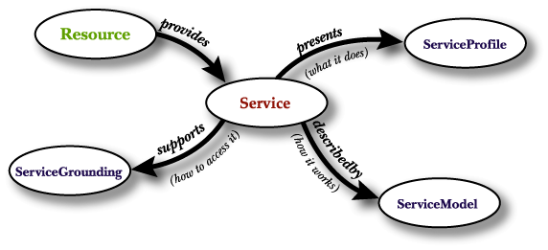
OWL-S
Capability specification
General features of the Service
Quality of Service
Classification in Service
taxonomies
Mapping to WSDL
communication protocol (RPC, HTTP, …)
marshalling/serialization
transformation to and from XSD to OWL
Control flow of the service
Black/Grey/Glass Box view
Protocol Specification
Abstract Messages
[M. Stollberg and A. Haller, 05]

Slide 20
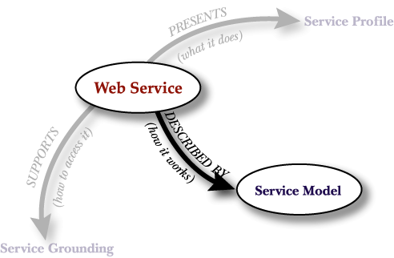
Process Model
Process Model
Describes how a service works: internal processes of the service
Specifies service interaction protocol
Specifies abstract messages: ontological type of information transmitted
Facilitates
Web service invocation
Composition of Web services
Monitoring of interaction
Source: Katia Sycara , Semantic Web Service Ontologies, HICSS 39, 2006

Slide 21
Definition of Process
A Process represents a transformation (function). It is characterized by four parameters
Inputs: the inputs that the process requires
Preconditions: the conditions that are required for the process to run correctly
Outputs: the information that results from (and is returned from) the execution of the process
Results: a process may have different outcomes depending on some condition
Condition: under what condition the result occurs
Constraints on Outputs
Effects: real world changes resulting from the execution of the process
Source: Katia Sycara , Semantic Web Service Ontologies, HICSS 39, 2006.

Slide 22
Atomic and Simple Processes
Atomic processes correspond to the actions a service can perform by engaging it in a single interaction;
composite processes correspond to actions that require multi-step protocols and/or multiple server actions;
simple processes provide an abstraction mechanism to provide multiple views of the same process.
Source: http://www.w3.org/Submission/OWL-S/

Slide 23
Web services and Data Interoperability
Loosely coupled nature of web services
Reduced inter dependence between components
Tremendous increase in schema/data level heterogeneities
Heterogeneous schemas/structures
Heterogeneous data formats and representations
Solution
Relate Web services to domain models
Domain models captured in OWL
Problem of mapping XML to OWL
Source: Amit Sheth, Web Services to Semantic Web processes

Slide 24
Data mapping in workflows and web services
One of the most important challenges of workflows
Data flow (mapping between components) more than control flow (workflow execution)
Data mapping in Web services is more complex
more independently developed systems
Issue of annotations with multiple ontologies
Use of Ontologies in Semantic Web Services
Automate service discovery, process composition; semantic description enable machine interpretable expression of service attributes, service data and compositions;
Shared semantic models and service annotations provide interoperable description of services and workflows.
Partially adapted from : Amit Sheth, Web Services to Semantic Web processes

Slide 25
Discovery
Syntactic Web Services
UDDI
Static discovery based tags/keywords
Not suited to automated discovery
Semantic-enabled solutions
Use Ontology based reasoning (e.g., OWL-S, WSMO, SWSA, …)
Hybrid methods (using machine learning techniques for indexing and logical reasoning)

Slide 26
Problems with UDDI
Centralised registry model not very popular
Private registries prevalent
Discovery requires solving two problems
Finding appropriate registry
Finding services in the registry
Semantic discovery:
Using semantic matching and reasoning for deciding on the degree of match between service request and advertisement.
Semantic search and query based on different service parameters and also inputs and outputs.
Source: Amit Sheth, Web Services to Semantic Web processes

Slide 27
Service Composition
Developers and service consumers can solve complex problems by combining different available basic services and creating a workflow to solve their problem requirements.
A composed service can include multiple basic and also other composed services.

Slide 28
Composite Services
Composite services are constructed using other service as building blocks.
The native services in a composition construct the sequence of business flows.
A composite service orchestrates the invocation sequence of discrete Web services into a meaningful end-to-end business process.
The composition and sequence of native web services can be defined through a Web service composition language BPEL (business process execution language).

Slide 29
Goal-oriented Service Composition
A user describes her/his overall goal by specifying the list of message types s/he can possibly input to the system (e.g. credit card, expiry date, budget, …), restrictions on their types.
Goal is formulated as a list of expected outputs.

Slide 30
Goal-oriented Service Composition- definitions
The requirements that are expressed to allow discovering a a Semantic Web Service are called atomic goals.
An atomic goal is an abstraction to describes requirements for the web services that expect/produce messages that a user is looking for.
Defining a goal is like defining a query that can be used to retrieve semantic web services form a repository.

Slide 31
Goal-oriented Service Composition- definitions
A role is the abstraction of the messages exchanged by the goals;
An abstraction of input and output messages.
Counterpart of input/outputs of the matching semantic web services.
A composite goal is a set of atomic goals together with the inter-connection and constraints that apply to roles and goals.

Slide 32
Semantic Web Services- composition
Using ontologies to extend the traditional Web Services usually focuses on:
the definition of data contained in the messages exchanged by Web Services
Describing functions (and functional attributes)
Describing profile (and non-functional attributes)
Definition of the composition of other Web Services to a particular service

Slide 33
Choreography vs Orchestration
Choreography describes how the service can be consumed from a user point of view (message exchange patterns).
Orchestration describes the workflow of the service, including internal computations and calls to external Semantic Web Services. Orchestration is generally hidden to the user.

Slide 34
Alternatives to capture the semantics of composite services
Finite State Machines
Statechart diagrams
Petri Nets
Process Algebra (or process calculi)

Slide 35
Finite State Machines
Finite State Machines (FSM) are used for modelling sequential behaviour that depends not only on inputs but also on the state of a system when an input is received.
FSM consist of five elements: states, state transition, conditions, input events, output events.

Slide 36
Finite State Machines
A state provides information about something that has already happened.
Transitions indicate a change of a state and are described by a condition.
Actions are activities that are performed at a given time.

Slide 37
Finite State Machines
FSMs are rule-based.
FSMs can be a useful mechanism to model the internal and external behaviour of services as a sequence of transitions between states.

Slide 38
Statechart Diagrams
FSMs can be a used a mechanism for describing the dynamic behaviour of the services; but in complex services and when the number of state may grow exponentially the complexity of FSMs can become unmanageable.
Statechart diagrams are proposed as an extension of the notion of FSMs to include the concepts of hierarchy, state clustering, modularity and concurrency.

Slide 39
Petri Nets
Petri Nets are mathematical models for describing concurrent, asynchronous and parallel behaviour of distributed systems.
Petri Nets are represented as bipartite graphs with place nodes, transition nodes and directed arcs.
Transitions may fire as long as sufficient tokens are available at the input places.

Slide 40
Petri Nets - issues
There some issues in using Petri Nets for modelling asynchronous distributed systems and (in our case web service compositions)
Scalability issues- the complexity of Petri Nets increases as the number of states increases.
Termination: does the Petri Net terminate?
Deadlock: Is there a state where no transition can fire?
…

Slide 41
Process Algebra
Process Algebra or Process Calculi (Л-Calculus)
Provides a formal foundation for modelling programs can run concurrently in parallel and which can interact with each other.
It provides a higher-level description of interactions, communications, and synchronisations between a set of independent processes.
The π –calculus approach offers concise notation with powerful reduction mechanisms, which facilitate specification of complex services.

Slide 42
Composite Services
42
Composite services are constructed using other service as building blocks.
The native services in a composition construct the sequence of business flows.
A composite service orchestrates the invocation sequence of discrete Web services into a meaningful end-to-end business process.
The composition and sequence of native web services can be defined through a Web service composition language BPEL (business process execution language)

Slide 43
BPEL
BPEL is an orchestrating language: it sets down exactly how the Web services will cooperate to carry out the overall business process.
In other words, you can use technologies such as SOAP and WSDL to build individual Web services, but with BPEL you specify how to combine individual services to enact an entire business process.
Source: Louridas, P., "Orchestrating Web Services with BPEL," Software, IEEE , vol.25, no.2, pp.85,87, March-April 2008

Slide 44
BPEL
BPEL has several core features. Actions are performed through activities , such as invoking a Web service or assigning a new value in an XML document.
Activities such as while or switch offer the developer control over activity execution.
It is designed to implement only the collaboration
In terms of logic BPEL offers only basic activities.
BPEL describes communication with partners using partner links, and messages exchanged by partners are defined using WSDL.

Slide 45
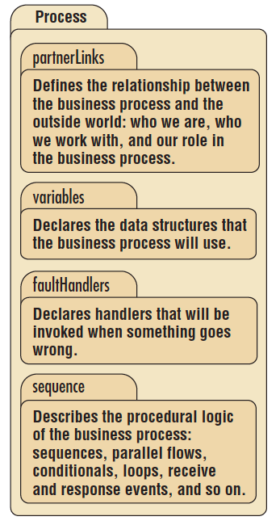
BPEL Structure
Source: Louridas, P., "Orchestrating Web Services with BPEL," Software, IEEE , vol.25, no.2, pp.85,87, March-April 2008

Slide 46
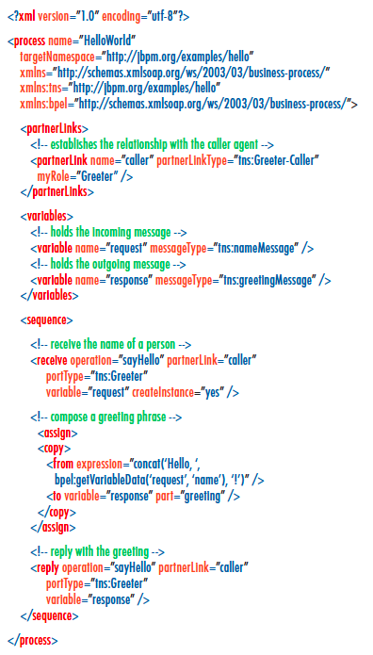
BPEL example
Source: Louridas, P., "Orchestrating Web Services with BPEL," Software, IEEE , vol.25, no.2, pp.85,87, March-April 2008

Slide 47
Cloud Computing
Cloud computing refers to a set of resources and services that are offered through the Internet.
The word “Cloud” is a metaphor for the Web- as the space for the computing and resources.
The main objective of Cloud Computing is to efficiently use distributed resources and provide sufficient storage, computing, memory and processing capabilities for large-scale operations and/or provide virtualised and reliable computing resources for applications and services.

Slide 48
The Cloud environment
The cloud environment can be regarded as a distributed environment that offers services via a communication network (usually the Internet and TCP/IP).
Users may not know the exact location of the resources that they use.
Resources can be shared among a large number of users.
Different service can be offered for storage, processing, handling the data and services in the Cloud.

Slide 49
Architecture
The services provided by Cloud Computing can be divided into three main categories:
Infrastructure-as-a-service (IaaS)
Platform-as-a-service (PaaS)
Software-as-a-service (SaaS)

Slide 50
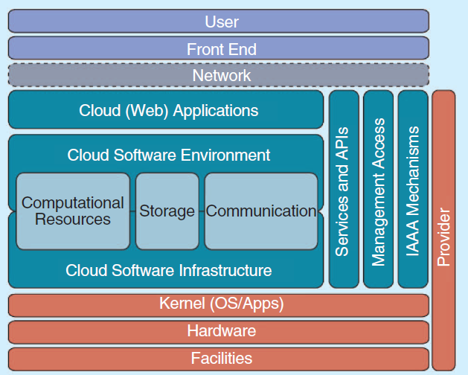
Cloud Computing Architecture
Source: Sadiku, M.N.O.; Musa, S.M.; Momoh, O.D., "Cloud Computing: Opportunities and Challenges," Potentials, IEEE , vol.33, no.1, pp.34,36, Feb. 2014

Slide 51
Infrastructure-as-a-service
This is the basic service provided by the Cloud.
This can involve providing and delivery of large-scale resources such as storage, processing, and network.
It gives the ability to remotely access the resources.
It can be based on pay-per-use model.
It can also help providing secure, reliable resources.
Examples: Amazon Elastic Computing Cloud (E2C).

Slide 52
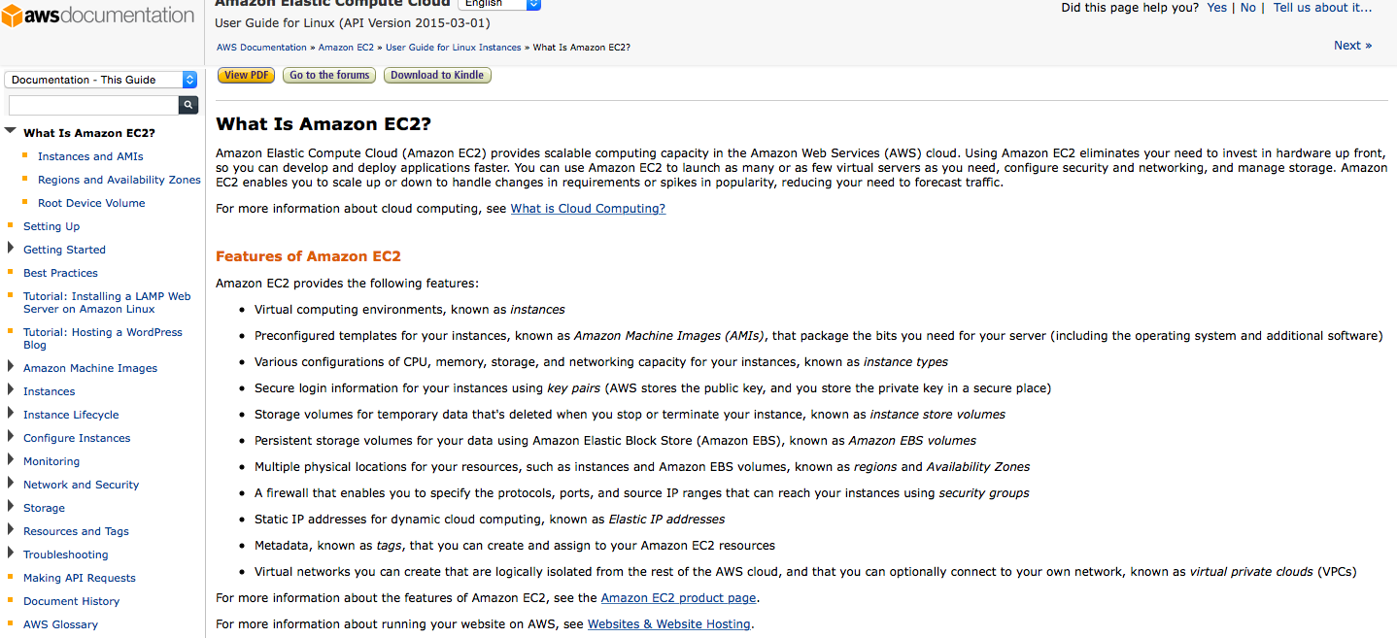
IaaS- Example: Amazon EC2
See the vide at: http://aws.amazon.com/ec2/

Slide 53
Platform-as-a-service (PaaS)
PaaS provides a set of application program interfaces to cloud applications.
It allows to provide platform applications and services to be offered as Cloud servcies.
PaaS allows the users to creates their software using tools and libraries that are offered by a provider.
Examples: Google App engine and Microsoft Azure.

Slide 54
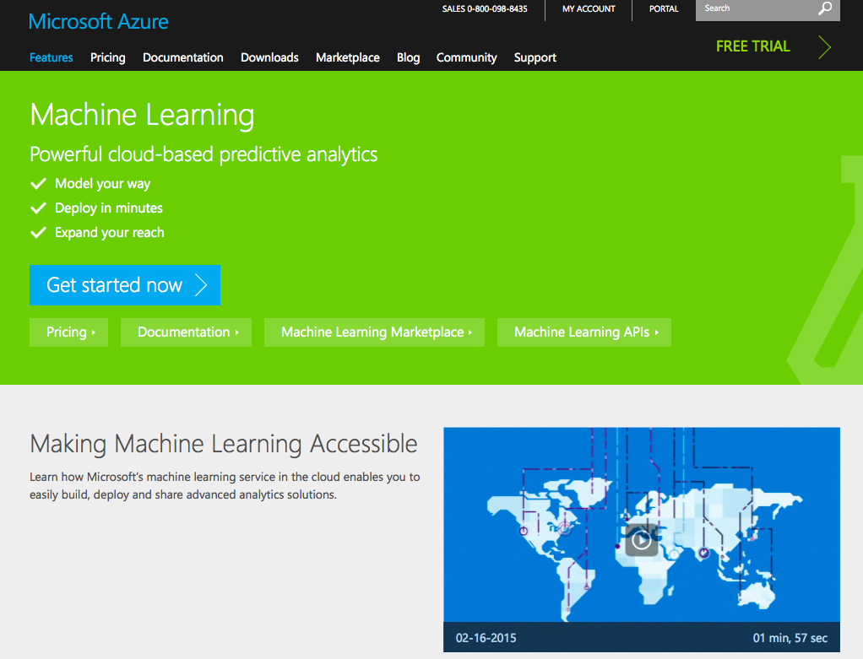
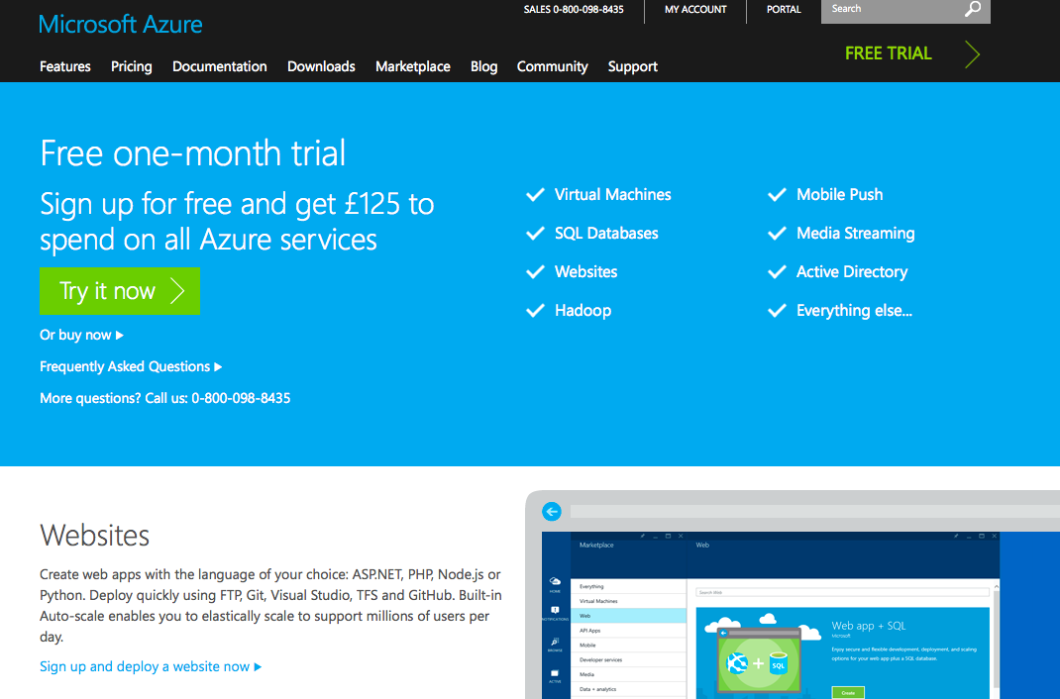
PaaS Example: Microsoft Azure

Slide 55
Software-as-a-service (SaaS)
SaaS provides services that can be directly used by end-users.
It is a software deployed in the Cloud (i.e. the internet).
It is an alternative to running applications on users computer or offering access to them via dedicated services.
In SaaS the services run on the Cloud platform and several resources can offer the same service and access and load balancing between them is done via the Cloud management and is transparent to the consumer.

Slide 56
Cloud: Benefits and Challenges
It can provide large-scale resources in reliable, secure and scalable ways.
It provides on-demand, ubiquitous and location independent access and resource pooling.
It can help to support and manage quality of services and reliability.
Two of the key challenges are privacy and security.
Latency in accessing the application and load balancing can be also other challenges.

Slide 57
Further reading
Sadiku, M.N.O.; Musa, S.M.; Momoh, O.D., "Cloud Computing: Opportunities and Challenges," Potentials, IEEE , vol.33, no.1, pp.34,36, Feb. 2014.
Louridas, P., "Orchestrating Web Services with BPEL," Software, IEEE , vol.25, no.2, pp.85,87, March-April 2008.
Bormann, C.; Castellani, A.P.; Shelby, Z., "CoAP: An Application Protocol for Billions of Tiny Internet Nodes," Internet Computing, IEEE , vol.16, no.2, pp.62,67, March-April 2012.

Slide 58
Acknowledgements
Some of the slides are adapted from the following resources:
Stollberg et al, Semantic Web Services Tutorial, 5th International Conference on Web Engineering (ICWE 2005), Sydney, Australia.
Semantic Web Services Tutorial, Michael Stollberg and Armin Haller, DERI, 3rd International Conference on Web Services (ICWS 2005), 2005.
Vipul Kashyap et al, The Semantic Web, Semantics for Data and Services on the Web, Springer, 2008.
Rudi Studer et al, Semantic Web Services: Concepts, Technologies and Applications, Springer, 2007.
Notes:
58

